Slide 1
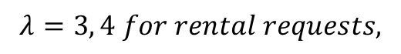

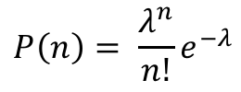
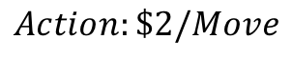

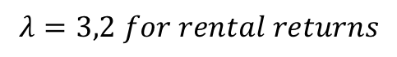
Reward: $10/Car Rental
Capability: 0~20 Cars/Shop
$$Action:\$2/Move$$
Max 5 Cars
No of Cars n Rented
is Expected No. of Cars Rented on each day
$$P\left(n\right)= \frac{λ^{n}}{n!}e^{−λ}$$
$$λ$$
$$λ=3, 4 for rental requests,$$
$$λ=3,2 for rental returns$$
$$γ=0.9$$

